Slide 1


Market Implied Conformal Volatility Intervals
Alejandro Canete
ACANETE@UCHICAGO.EDU

Slide 2
Agenda
Context
Motivation
Proposed method
Experiments and Results
Conclusions and Questions

Slide 3

Context

Slide 4
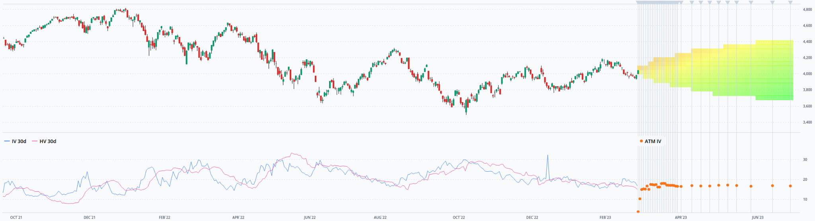
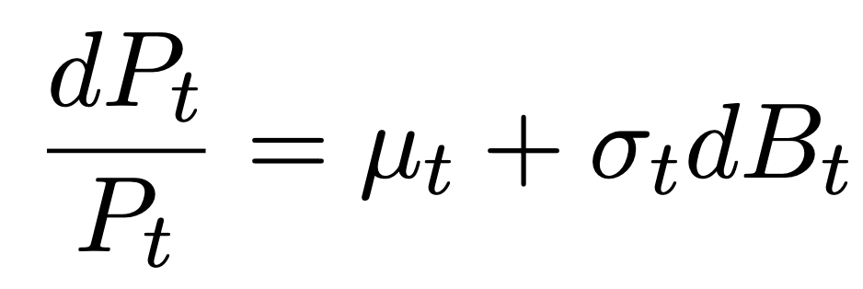
Realized Volatility: “what happened in the past”*
https://dashboard.orats.com/analyzer/tradebuilder
Realized
Expected
“Instantaneous”
*https://www.nasdaq.com/glossary/r/realized-volatility

Slide 5
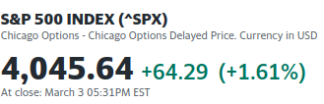
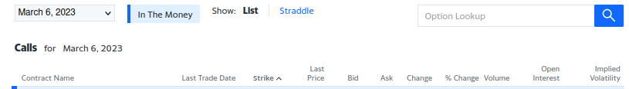
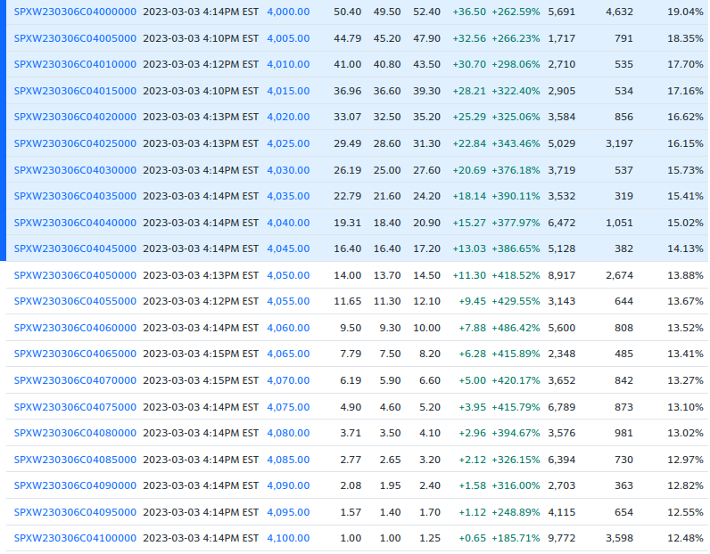
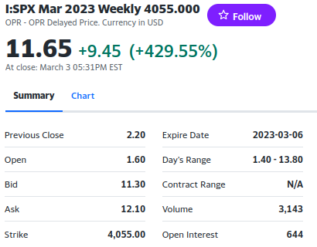
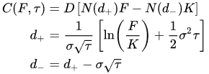

Option Prices and Implied Volatility: Implied volatility is reflected in option prices
https://en.wikipedia.org/wiki/Black%E2%80%93Scholes_model
https://finance.yahoo.com/quote/%5ESPX/options?p=%5ESPX

Slide 6
Motivation

Slide 7
Question
Can market expectations be used to build realized volatility prediction intervals?

Slide 8
Proposed Method

Slide 9

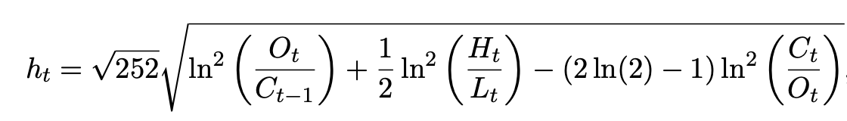
Volatility Proxies
We use the VIX index as a proxy for implied volatility
We use daily prices on SPY (as a proxy of SPX) to estimate the one day ahead realized volatility
References
Yacine A ̈ıt-Sahalia and Robert Kimmel. Maximum likelihood estimation of stochastic volatility models. Journal of financial economics, 83(2):413–452, 2007
Robert E Whaley. Understanding the vix. The Journal of Portfolio Management, 35(3): 98–105, 2009.
Marcin Faldzin ́ski and Magdalena Osin ́ska. Volatility estimators in econometric analysis of risk transfer on capital markets. Dynamic Econometric Models, 16:21–35, 2016.

Slide 10
Executive Summary
Market normalizer + Weighted Quantiles + ACI update
Measure of uncertainty (score normalizer) from the market
Weighting scheme relevant to the use case at hand
We adjust the significance-level using ACI’s update

Slide 11

Base model
“Adjustment” is needed, because:
Different time frames
Different measures
Jacob Loveless, Sasha Stoikov, and Rolf Waeber. Online algorithms in high-frequency trading. Communications of the ACM, 56(10):50–56, 2013.

Slide 12
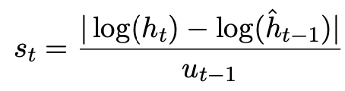
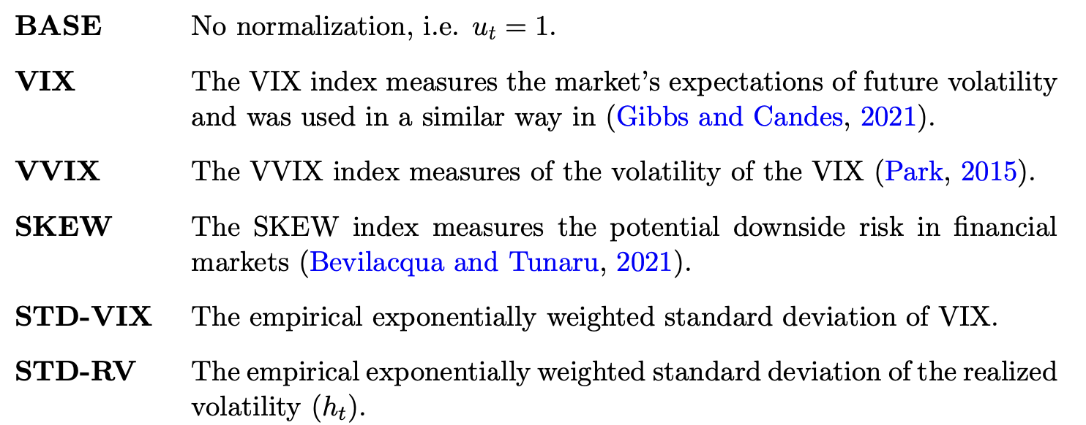
Non-conformity scores
https://www.cboe.com/indices/

Slide 13
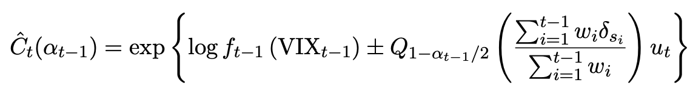
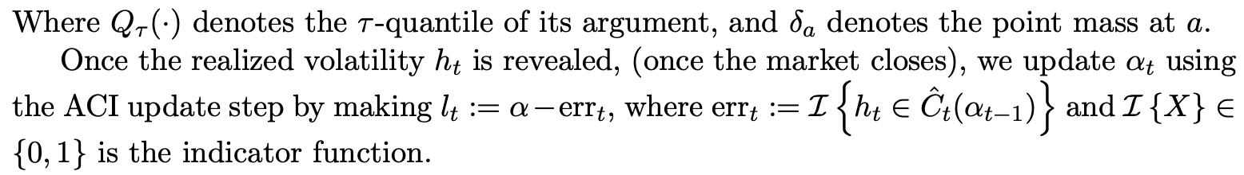


Predictive Intervals
Exponentially Weighted Quantiles
ACI update
References
ACI: Isaac Gibbs and Emmanuel Candes. Adaptive conformal inference under distribution shift. Advances in Neural Information Processing Systems, 34:1660–1672, 2021.
Rina Foygel Barber, Emmanuel J Candes, Aaditya Ramdas, and Ryan J Tibshirani. Conformal prediction beyond exchangeability. arXiv preprint arXiv:2202.13415, 2022.

Slide 14
Experiments and Results

Slide 15
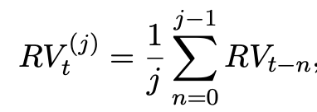
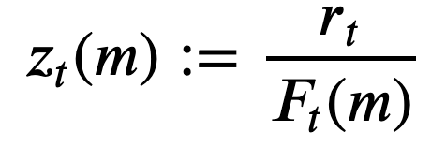
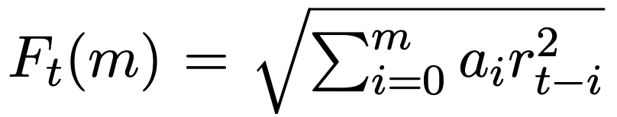
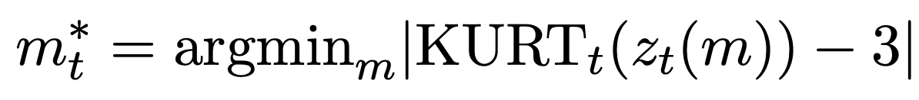
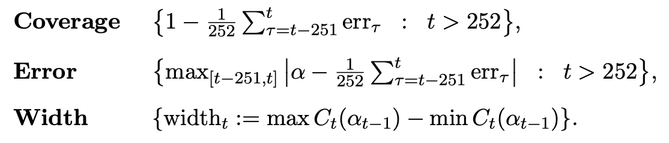
Experiments
Data
VIX and SPY from https://finance.yahoo.com/
SKEW and VVIX from https://www.cboe.com/
EOD (~ 4K days)
Other base models
HAR
NoVaS
Metrics
HAR: Adam Clements and Daniel PA Preve. A practical guide to harnessing the har volatility model. Journal of Banking & Finance, 133:106285, 2021.
NoVas: Dimitris N Politis and Dimitrios D Thomakos. NoVaS transformations: flexible inference for volatility forecasting. Springer, 2013.

Slide 16
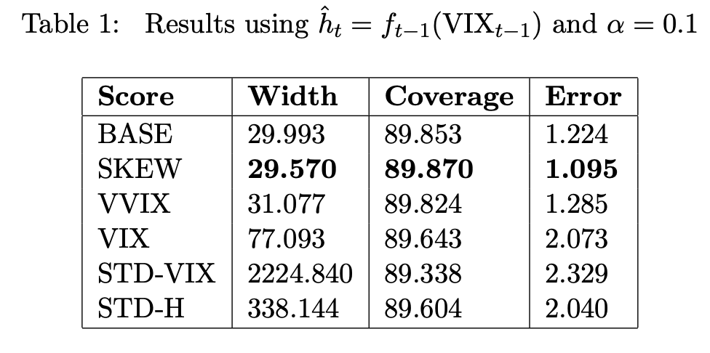
Results

Slide 17
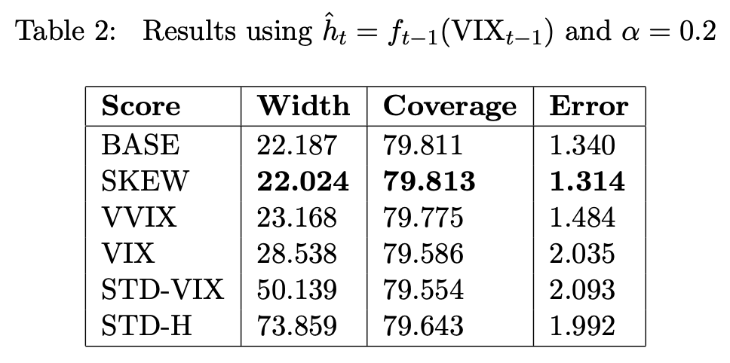
Results

Slide 18
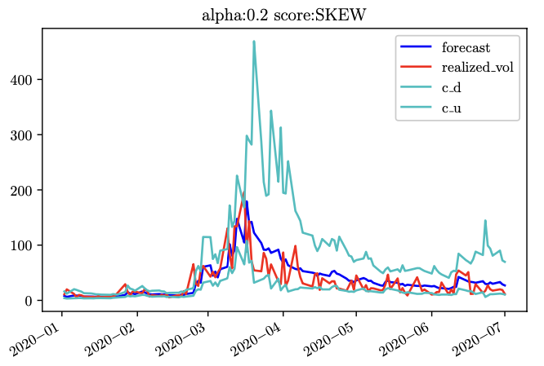
Results

Slide 19
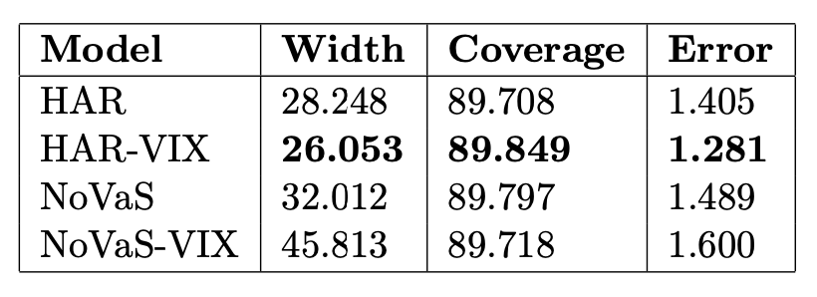
Results

Slide 20
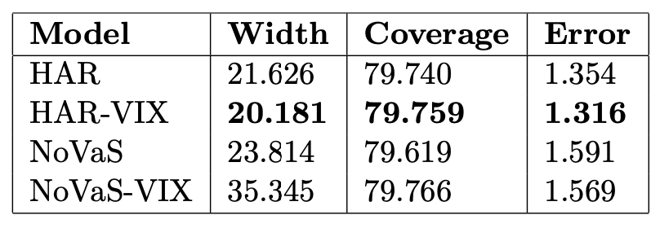
Results

Slide 21
Conclusions and Questions

Slide 22
Conclusions and Questions
Conclusions
Method is consistent (in terms of coverage) across normalizers
All market driven normalizers (SKEW, VVIX) outperformed pure historical ones (STD-VIX, STD-H)
SKEW seems to outperforms VVIX as a normalizer
VIX was beneficial for HAR
Outstanding Questions
Why SKEW outperforms VVIX?
Can Width be used as a pricing factor?
Can normalizers be defined directly on option prices?
Would improve volatility proxies alter the results?

Slide 23
Thanks!

Slide 24
Appendices

Slide 25
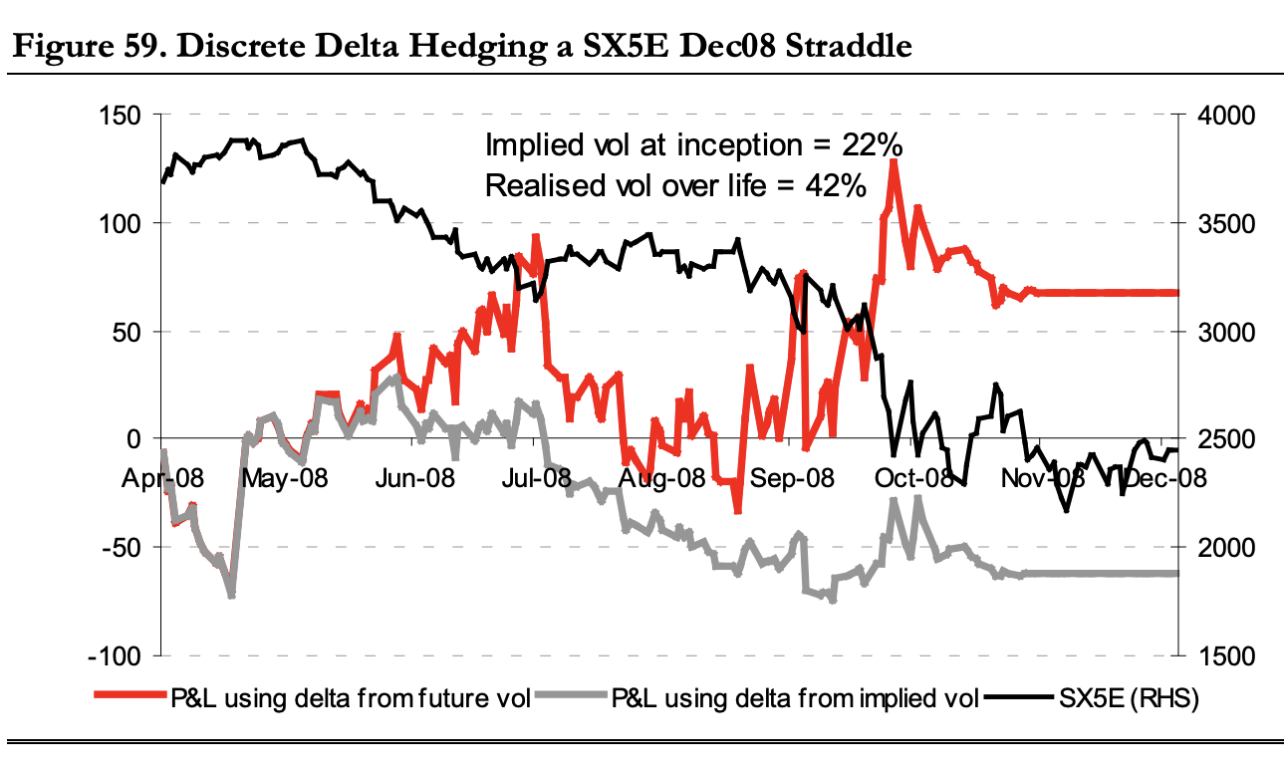
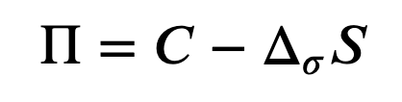
Why? Traders need to predict realized volatility to manage their risks
Delta Hedged Call
Call
Delta
Stock Price
Reference: Bennett, Colin, and Miguel A. Gil. "Volatility trading." Trading volatility, Correlation, Term Structure and Skew, Santander Equity Derivatives (2012).

Slide 26
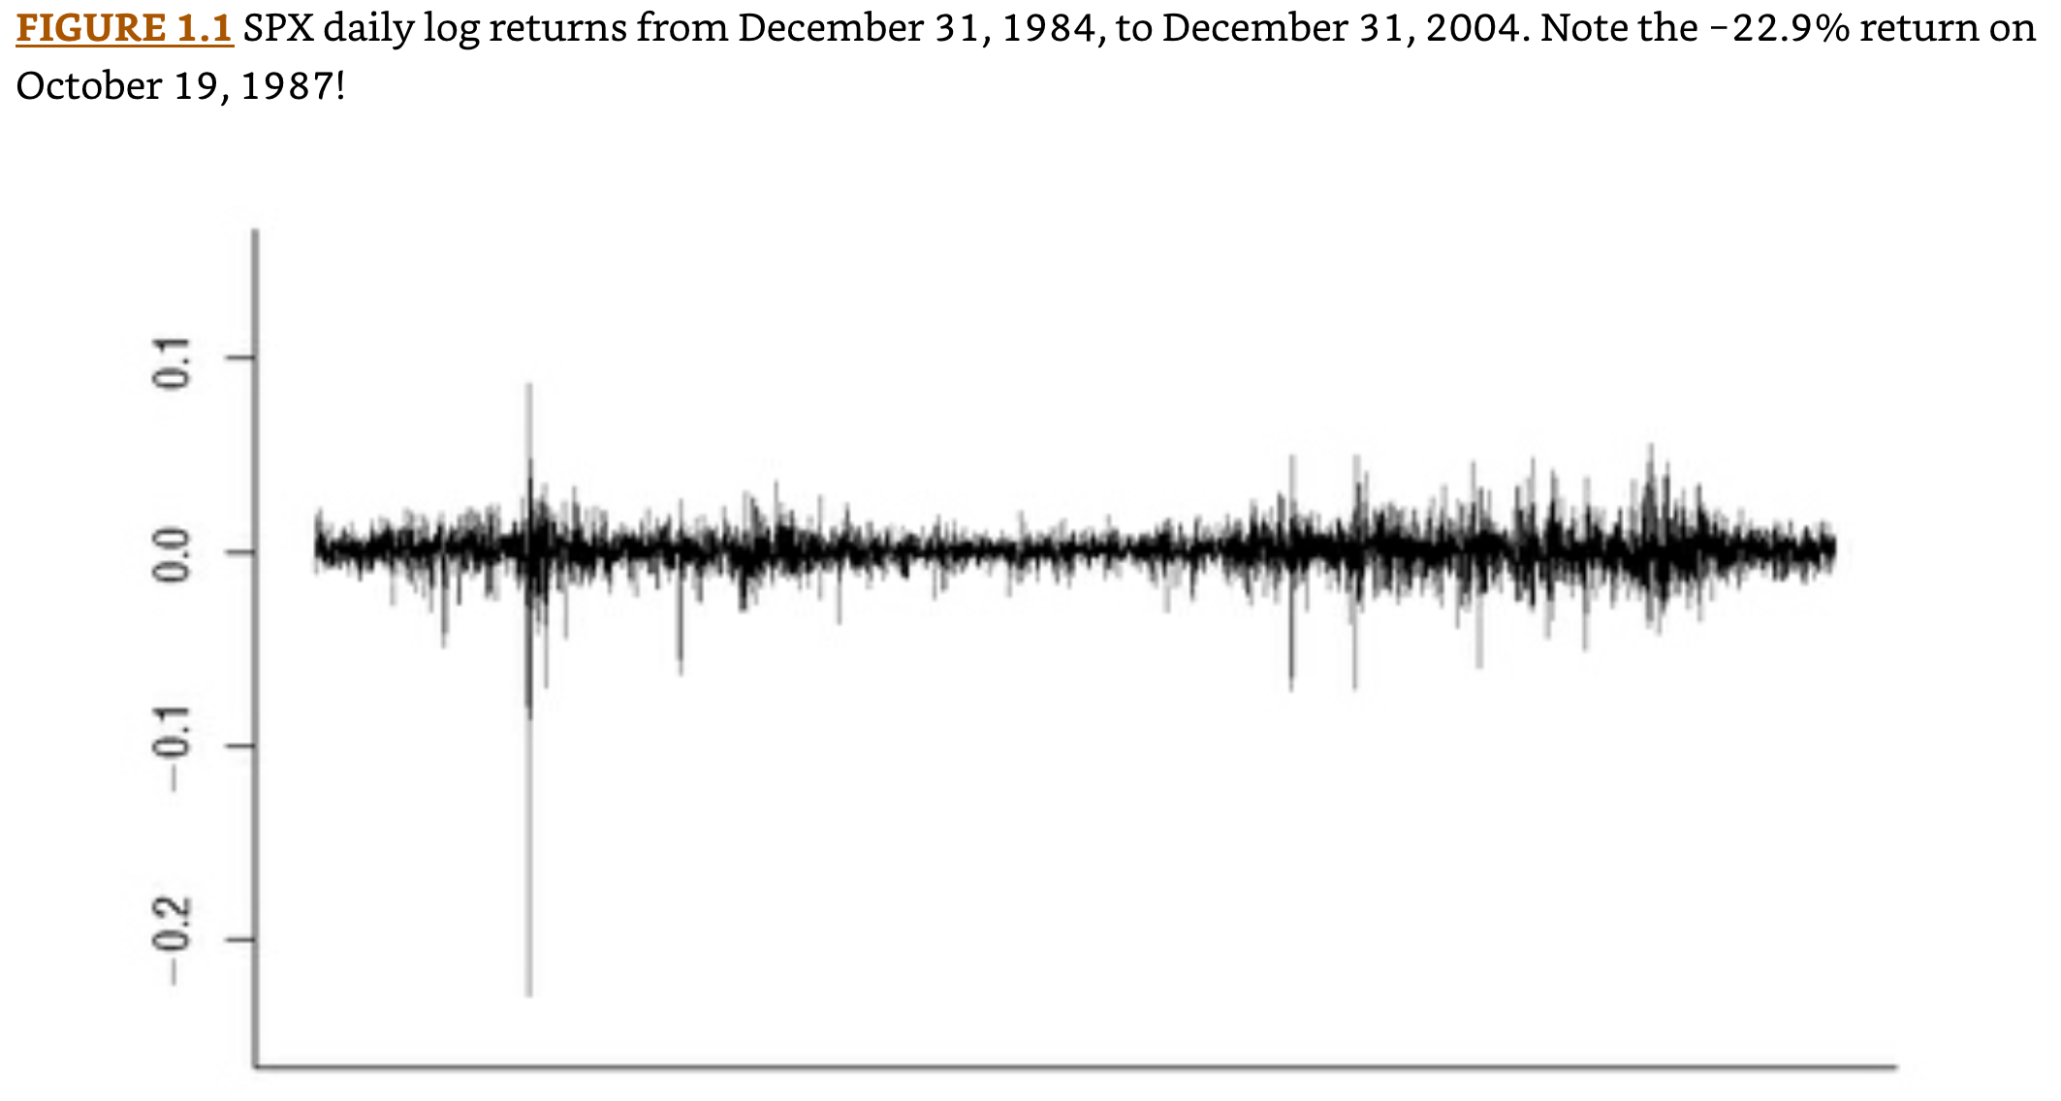
Volatility : The standard deviation of asset returns
Reference: Gatheral, Jim. The volatility surface: a practitioner's guide. John Wiley & Sons, 2011.

Slide 27
Option Prices and Implied Volatility: Implied volatility is reflected in option prices
https://en.wikipedia.org/wiki/Black%E2%80%93Scholes_model
https://finance.yahoo.com/quote/%5ESPX/options?p=%5ESPX

Slide 28
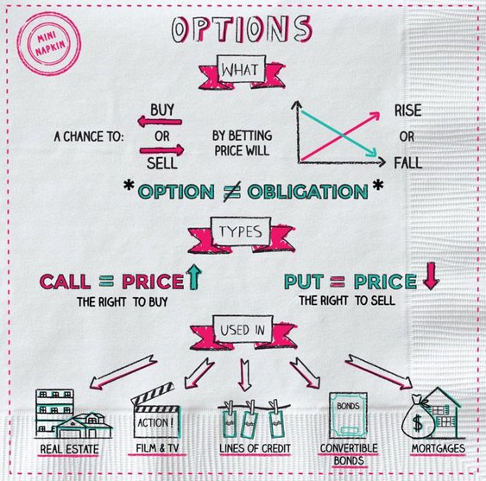
Options : Options provide the right to buy or sell an asset at a given strike price by a certain expiration date
https://napkinfinance.com/napkin/finance-options/

Slide 29
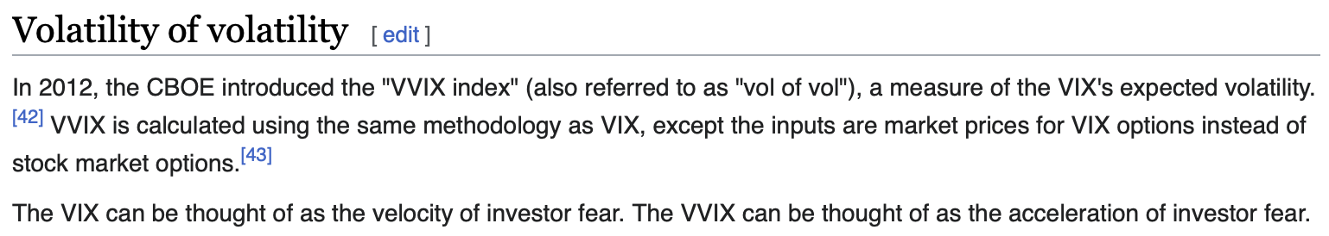
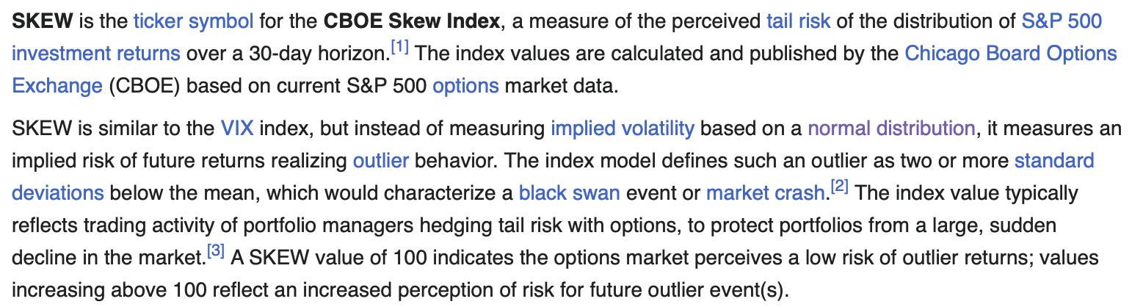
VVIX and SKEW
https://en.wikipedia.org/wiki/VIX#VVIX
https://en.wikipedia.org/wiki/SKEW

